Slide 1

Terrainosaurus
Terrain Generation
Using Genetic Algorithms
Ryan Saunders
Texas A&M Student Research Week
03/29/2005

Slide 2


Overview
Introduction
Motivation
  Applications of terrain generation
  Characteristics of an idealized t-gen methodology
Background
  Current methods
  Terrain model representation
  Genetic algorithms
The algorithm
  Phase I: Construct a terrain type database
  Phase II: Design the terrain layout
  Phase III: Generate the heightfield
Discussion & future work

Slide 3
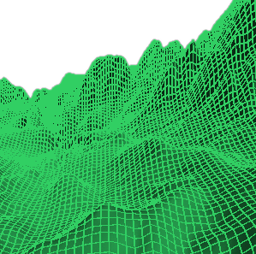

Terrainosaurus
Terrain generation for dummies
A novel approach to terrain generation
  User-oriented
  Physically-based
  Extensible

Slide 4

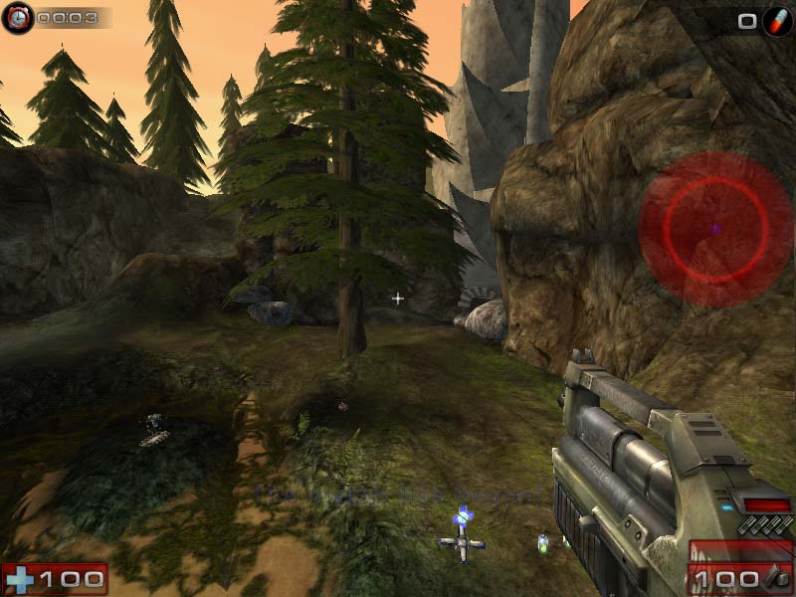
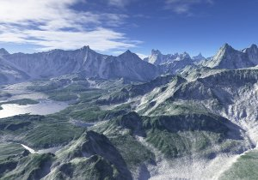
Potential Applications
Why would you want to do this?
Art
Architectural rendering
Military training exercises
CG movies
Games

Slide 5
Idealized Terrain Generation
In a perfect world…
Allowing a high degree of control, but requiring only a low baseline amount of input
Easy to use, with only intuitive user inputs
Able to produce a wide variety of recognizable types of terrain, in believable relation to each other
Realistic, providing a plausible simulation of the real world
Extensible, to support new types of terrain
Useful at arbitrary levels-of-detail (LOD)
Fast enough to run in real-time

Slide 6
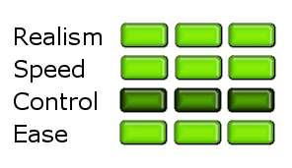
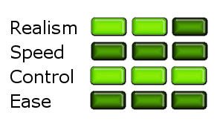
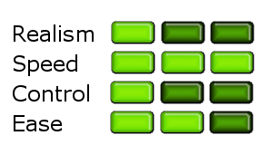
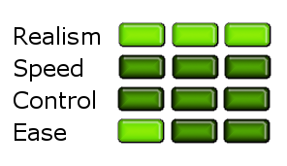
Current Terrain Generation Methods
Strengths & Weaknesses
GIS Data
Sculpting (e.g., Terragen)
Procedural (e.g., fractals)
Simulation (e.g., erosion)

Slide 7

Terrain Model Representation
Heightfields & other things
Heightfield – the most common
  2D grid of elevations h=f(x,y)
    Precludes representation of caves & overhangs
  Real-world surveying data available
  Ideal for optimized rendering and collision detection
Other possible representations
  Polygonal mesh
  Implicit function

Slide 8


Genetic Algorithms
How to solve really hard problems
Genetic algorithm (GA): any of a family of techniques for solving difficult optimization problems by analogy to Darwinian natural selection
  GAs are useful for finding approximate solutions when the optimal solution is unknown or infeasible to calculate
  A candidate solution (a chromosome, in GA parlance) is decomposed into interchangeable subunits called genes
  A population of such chromosomes is evolved for some number of generations, allowing multiple potential solutions to be explored simultaneously
  The “goodness” of a solution is measured by an objective function (the fitness function), and the more promising solutions are “cross-bred” and “mutated” to explore nearby solutions which might be even better

Slide 9
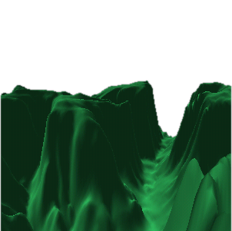
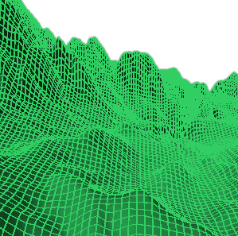
Phase I
Constructing a terrain library
The user creates a database of heightfield data (normally from a GIS data provider), classified into logical terrain types (e.g., “Sierra Nevada mountains”, “midwest prairie”, “sand dunes”)

Slide 10
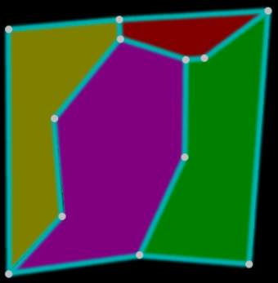
Phase II
Laying out the terrain
The user expresses his design for the terrain by sketching a 2D map of polygonal terrain regions, providing the size, shape and relative placement of the different terrain types

Slide 11
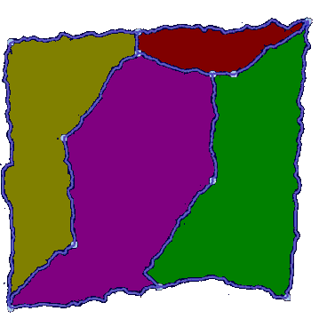
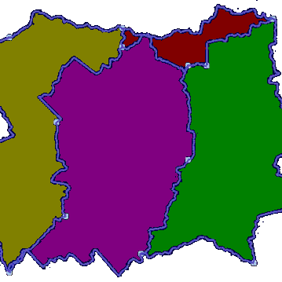
Phase II
Refining region boundaries
In order to prevent the appearance of noticeable artifacts in the generated heightfield (caused by the unnaturally straight boundaries drawn by the user), the user’s boundaries are replaced with irregular, GA-generated boundaries. The shape of the generated boundary can be controlled by a smoothness parameter to the GA.
High smoothness value
Low smoothness value

Slide 12
Phase III
The general idea
Construct progressively higher-resolution versions of the heightfield, with each successive version based on the previous
  By using the previous LOD as a rough “pattern” to approximate, we ensure that macro-level details of the heightfield are fixed before we worry about the micro-level details
We do this using a genetic algorithm that searches for an arrangement of high-resolution chunks of elevation data that:
  “fit” the shape of the lower-resolution heightfield
  display the appropriate terrain type characteristics in each region
Resample
Replace

Slide 13
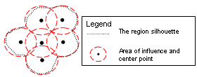
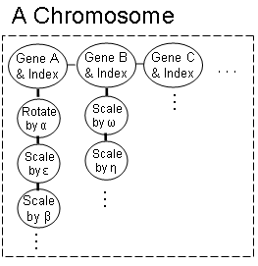
Phase III
The heightfield refinement GA
A heightfield can be represented as a chromosome containing a 2D, rectangular grid of overlapping, circular genes of a certain radius, in which each gene holds a chunk of elevation data from one of the input samples
  The genes may be mutated independently and traded between chromosomes
  When we’re done, we can turn a chromosome back into a heightfield with standard image compositing operations

Slide 14
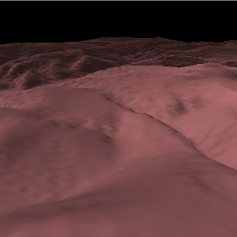
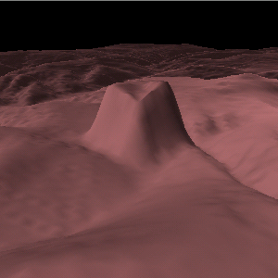
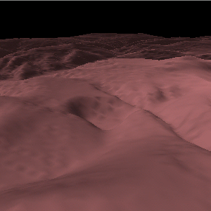
Phase III
Mutation & crossover operators
Just as a heightfield can be interpreted as a grayscale image (and vice versa), the mutation and crossover gene operations correspond to image manipulation operations
  The effect of these operations diminishes towards the boundary of the gene due to blending between adjacent genes
Original heightfield
Vertical offset mutation
Rotate mutation

Slide 15
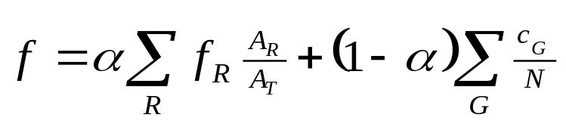
Phase III
The fitness function
The fitness function is a scalar function returning [0,1], giving an evaluation of how “good” a particular chromosome is. Our fitness function is:
f_{R} the fitness of region R
c_{G} the compatibility of gene G with the pattern heightfield
α relative weighting factor
A_{R} area of region R
N number of genes
A_{T} total area of heightfield

Slide 16
Phase III
Fitness evaluation: the fitness of an individual region
To measure the characteristics of a region of terrain, we use a number of different techniques
  Simple statistics (min, max, mean, variance) of physical quantities such as elevation and slope
  Physical features (edges, peaks, etc.) extracted with conventional computer vision techniques
  Frequency spectrum coefficients of the FFT

Slide 17
Phase III
Fitness evaluation: gene compatibility
The compatibility of a gene with its local environment is a measure of its divergence from the mean elevation and gradient of the pattern heightfield it is trying to match
  Compatibility is measured with a 1D Gaussian function centered over the target elevation/gradient

Slide 18
Evaluation
How well we met our goals
Low amount of user input required
  (+) Single terrain-type case is trivial
Moderate degree of user control afforded
  (+) User can create arbitrarily complex terrain regions
  (-) User has little control over location and orientation of features (e.g., cliffs, individual mountain peaks)
Easy to use, with intuitive inputs
  (+) User design is done visually (2D map) and by example (terrain library)
  (+) Most free parameters are quality-related (GA population size, number of cycles, level-of-detail)

Slide 19

Evaluation
How well we met our goals
Extensible, able to produce diverse terrain types
  (+) New terrain types can be added simply by finding new sample heightfields
  (-) Terrain type analysis is too sensitive to oddities in the input samples (e.g., lakes)
    Computer-aided terrain-type classification and segmentation could reduce or eliminate this problem
  (-) Terrain types characterized by large variations in feature content (e.g, Monument Valley) are not likely to be well reproduced with the current fitness function
    A more detailed analysis of the terrain feature model might yield a more complete fitness function

Slide 20
Evaluation
How well we met our goals
Realistic
  (+) Real-world data is used as the raw material for generating the terrain, resulting in plausible detail at both low and high frequencies
  (-) Semantic constraints (e.g., rivers must flow downhill) are not enforced
Arbitrary level-of-detail (LOD)
  (+) Can generate at any LOD for which data can be provided
Fast enough to run in real-time
  (-) Not exactly…in fact, it’s rather slow
  (+) Many of the operations are inherently parallelizable, suggesting that a GPU-centric implementation might offer a significant speed boost

